Slide 1
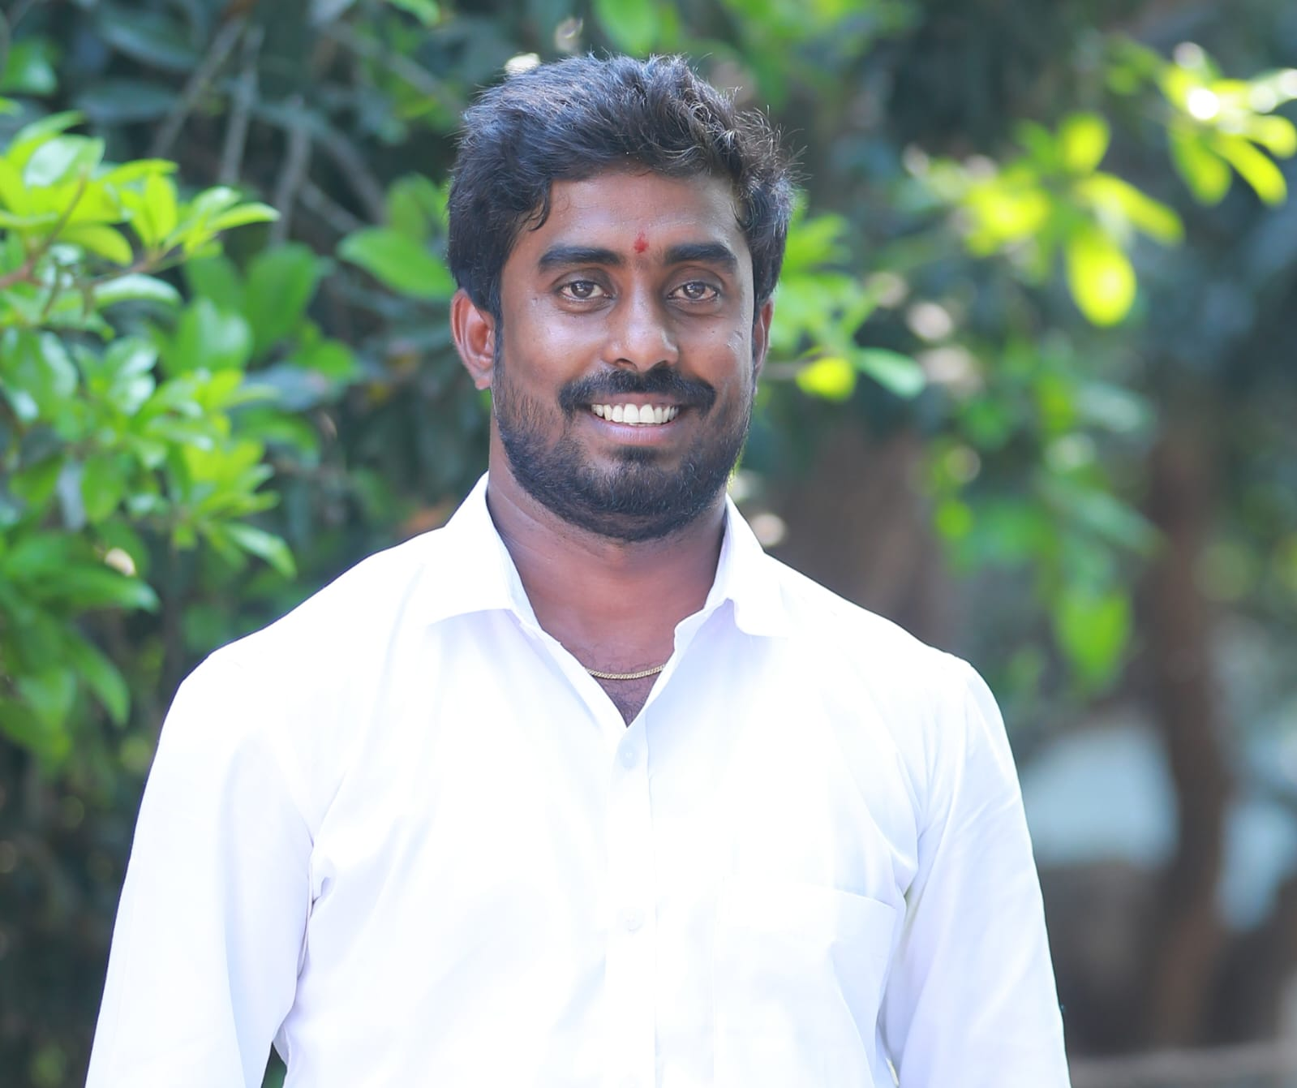
Gangadhar Andraju, Senior Quality Engineer ,Salesforce(Sales cloud)
Professional Summary
Over 4+ years of IT experience and worked Extensively in Manual testing ,SFDC testing
Extensive experience in Sanity testing, Smoke testing, salesforce testing, Regression testing, and Functional testing..
Proficient in all cycles of test life cycle from test planning to defect tracking and managing defect lifecycle..
Experience in SFDC Admin tasks like User creation, Profile, role, Permission set, Sharing rule etc....
Tested functionality in SFDC related to Account, Opportunity, and Lead creation..
Reported Bugs and followed up on bug tracking tools like JIRA
Ability to Work closely with developers, business analysts, and other stakeholders to understand requirements and provide feedback on system behavior.
Gangadhar.andraju@brillio.com
Hyderabad-Aqua ,India
Industry Experience:
Salesforce QA (Sales Cloud )
Core Skill Sets
Expertise in Functional & salesforce (SFDC) Testing (Sales cloud ).
Experienced in Salesforce applications within Health care, Financial Services, and Education domains .
Extensive experience in Sanity testing, Smoke testing, salesforce testing, Regression testing, and Functional testing.
Proficient in all cycles of test life cycle from test planning to defect tracking and managing defect lifecycle.
Reviewing and Understanding the User Stories.
Project Experience
Cigna :Clinical research project, Sales Cloud.
The internal Committee for Biomedical Ethics is an independent body CTO organization that reviews every human or animal subject.
Study proposed by and/or involving any employee of the organization to safeguard ethical conduct of research.
The internal Committee Biomedical Experiments has the goal to ensure compliance for all biomedical experiments in the CTO organization and evaluates study proposal in regular ICBE meetings.
Responsibilities :
Reviewing and Understanding the User Stories.
Preparation of Test cases in Sprint wise. Responsibilities.
Involved in Execution in different Sand boxes.
Reporting and tracking of defects in Jira.
Certifications
Salesforce Certified Administrator.
Recent Roles
Senior Quality Engineer
Salesforce QA
Senior test engineer
Key Clients
Cigna
Ford
Hub portal
©2024 Brillio | 1

Slide 2
Gangadhar Andraju, Senior Quality Engineer ,Salesforce(Sales cloud)
FORD:
DRE Project provides digital marketing and advertising solutions to Ford and Lincoln dealers, giving them the platform to drive more sales.
With a foundation built by Ford Motor Company and its franchise dealers, and being the only joint venture of its kind, Ford Direct understands the automotive and dealer business.
Responsibilities :
Understanding the Business Requirements based on User Stories.
Develop detailed test plans based on business requirements.
Create comprehensive test cases covering various aspects of Sales Cloud functionalities.
Provided regular manual test status updates and reports to project stakeholders
Log and track defects, and work closely with developers to resolve issues
HUB PORTAL :
The Hub portal is learning platform within salesforce sales cloud is a learning solutions and offers different courses to the students.
Hub portal provides a seamless and continuous learning experience that enhance sales productivity and performance
It having key concepts like Personalized learning experience.
Responsibilities :
Attended the daily stand-up calls
Reviewing and Understanding the User Stories Develop detailed test plans based on business requirements.
Create comprehensive test cases covering various aspects of Sales Cloud functionalities.
Provided regular manual test status updates and reports to project stakeholders
Collaborated with stakeholders to define acceptance criteria and participated in user acceptance testing (UAT) phases
©2024 Brillio | 2

